Slide 1
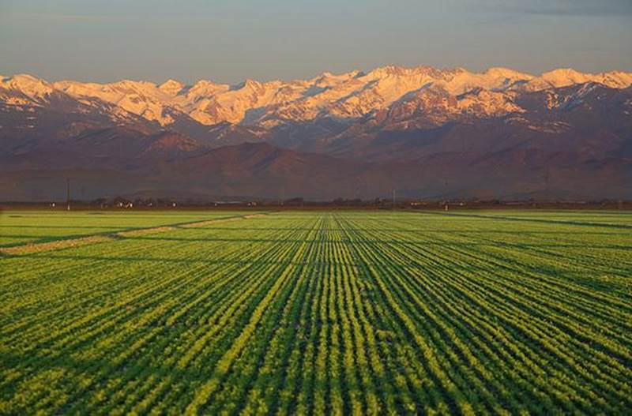
Vicki Kretsinger Grabert (LSCE) June 11, 2018 Presentation at Stanford University Water in the West Uncommon Dialogues
Groundwater Quality and SGMA:
Recharge, Nitrate, and Other Considerations

Slide 2
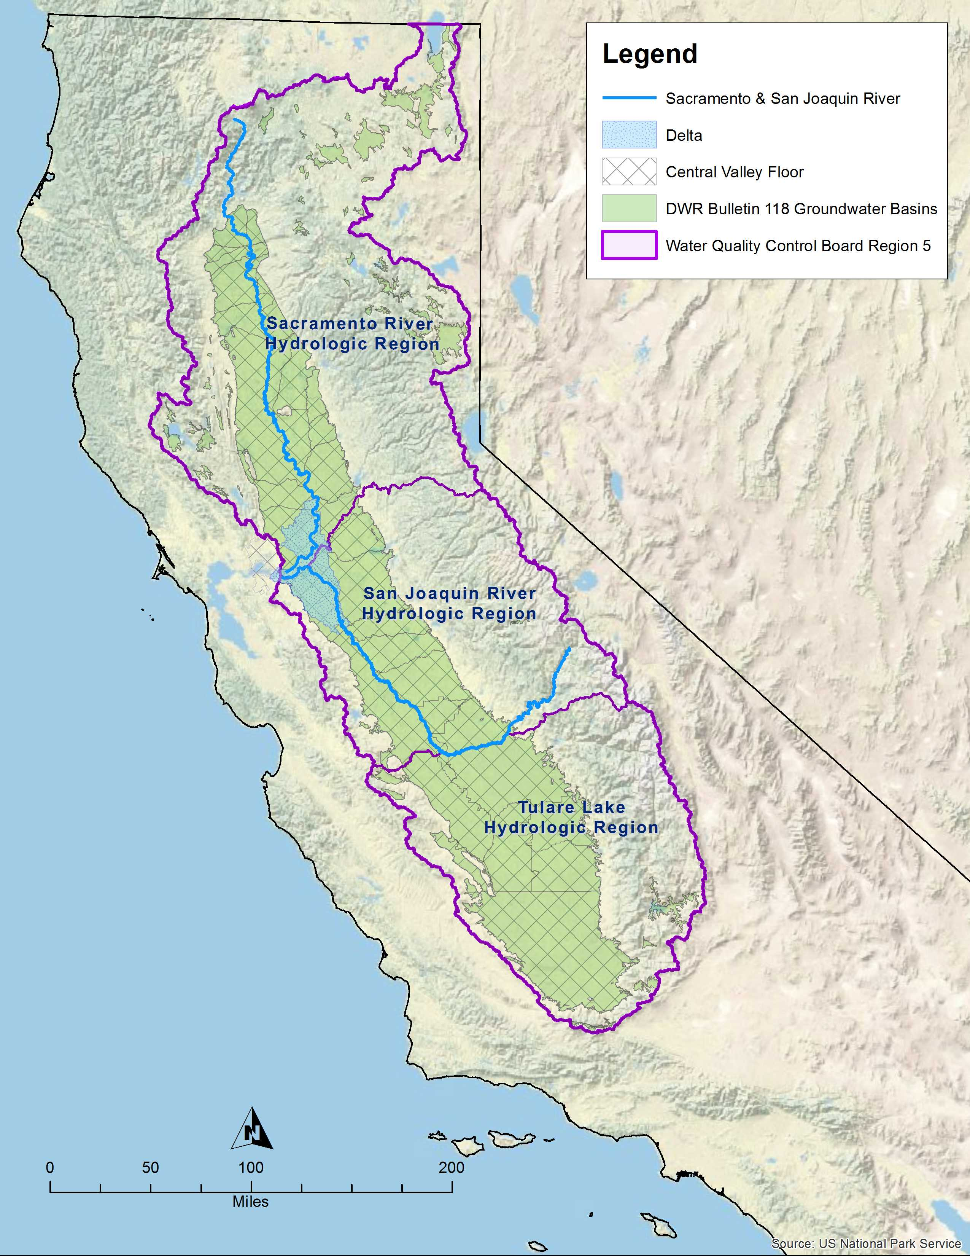
SGMA and Other Technical, Policy, & Regulatory Considerations
Central Valley Ambient
Groundwater Quality Conditions
Nitrate and Salt
SNMP Archetype Study
Evaluate Management Approaches
Benefits and Limitations
CDFA Recharge Project Findings
SGMA Synergies with Other Programs

Slide 3
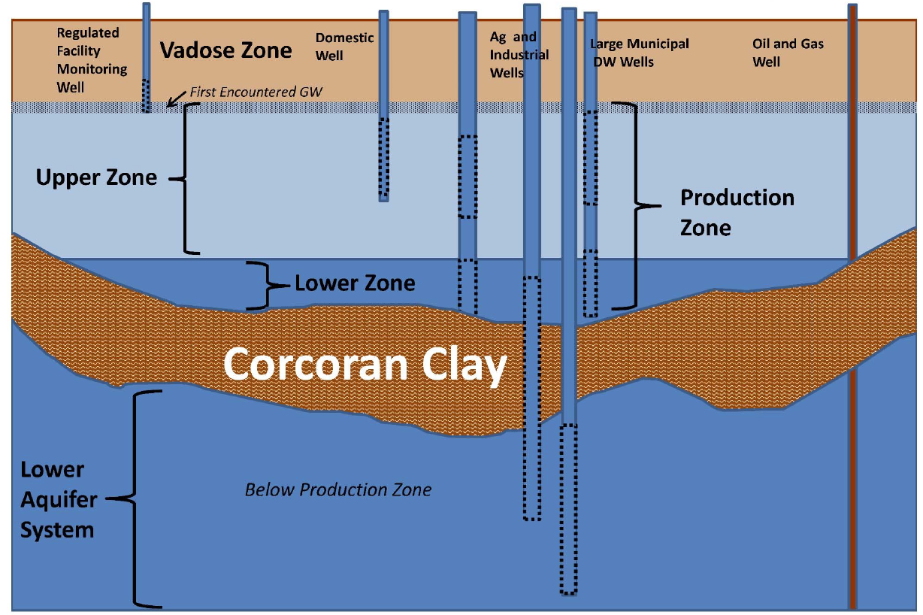
Depth to Bottom of Upper Groundwater Zone
Variable across Central Valley;
1 sq. mile interpretation
Numerous datasets; focus on
domestic well depths
161-320 ft

Slide 4
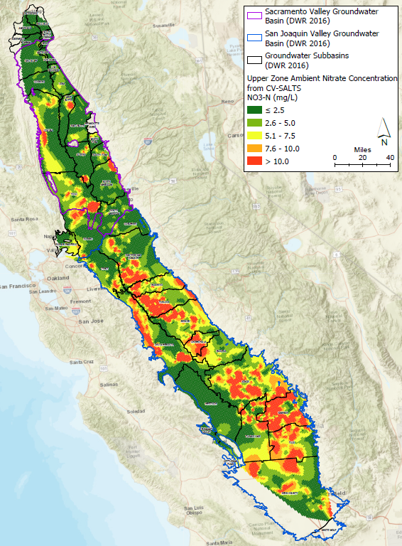
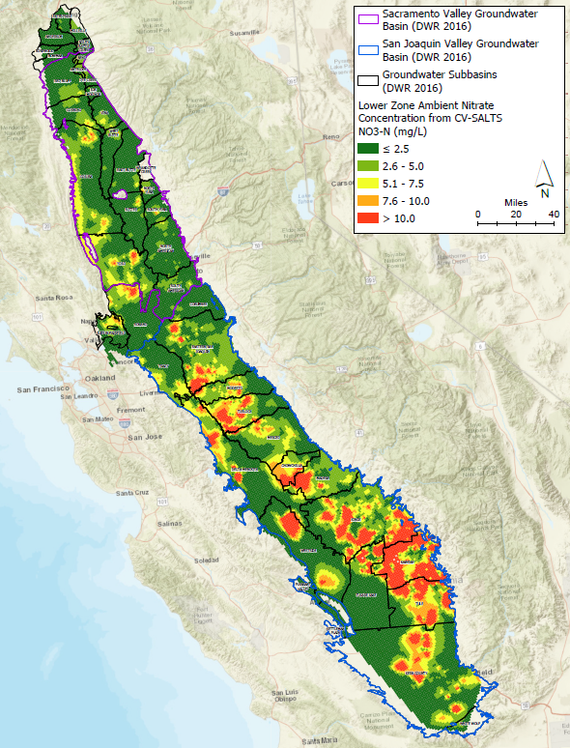
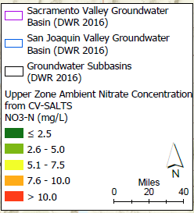
<2.5 mg/L
UPPER ZONE
NITRATE
LOWER ZONE
NITRATE
10 mg/L

Slide 5
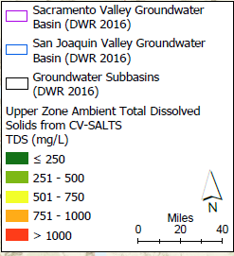
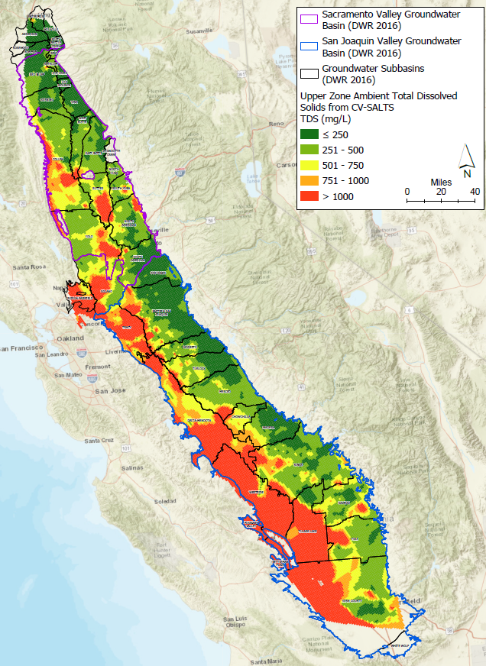
251-500 mg/L
UPPER ZONE
TDS
LOWER ZONE
TDS
>1,000 mg/L

Slide 6
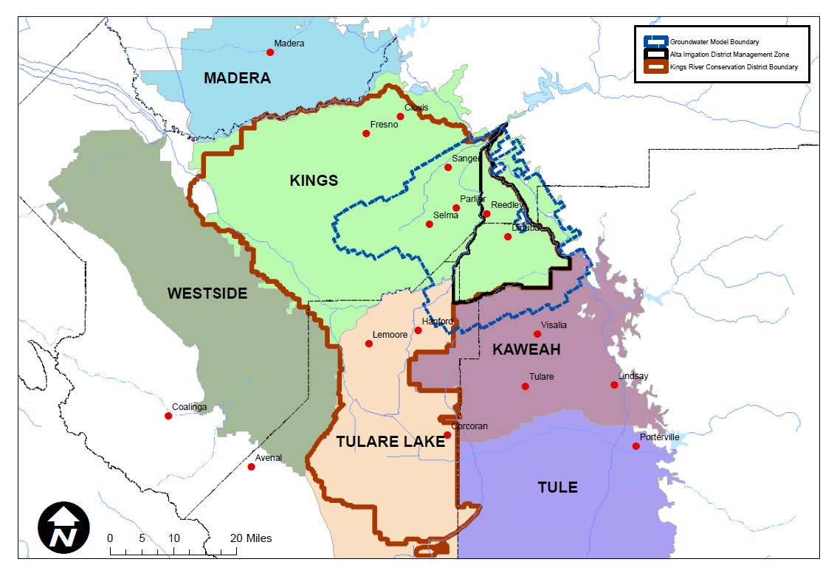
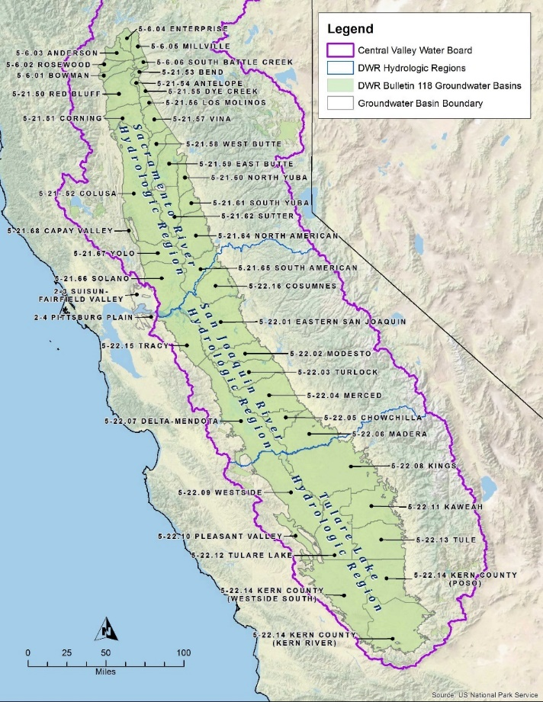
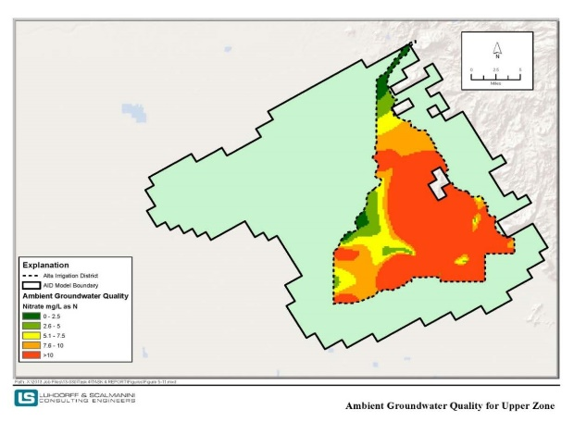
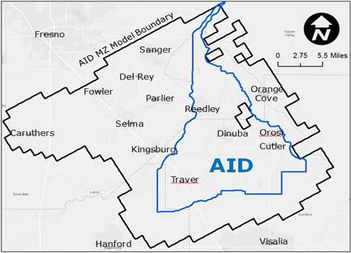
e
Management Zone: Alta Irrigation District Archetype
Evaluation of Salt and Nitrate Management Approaches
“Discrete Regulatory Compliance Unit within a Groundwater Basin/Subbasin”
HIGH NITRATE
IN GROUNDWATER
AID GROUNDWATER
MODEL AREA
Collaborative Nitrate Management in an Area within a Groundwater Basin/Subbasin

Slide 7
Designed Strategies for Salt & Nitrate Management
Increased irrigation efficiency + local recharge
Shifts to drip Irrigation Systems
IRWM projects
Decreased nitrogen loading
Dairy General Order
Irrigated Lands Regulatory Program
POTW Effluent
Scenario 1
Scenario 2
Scenario 3

Slide 8
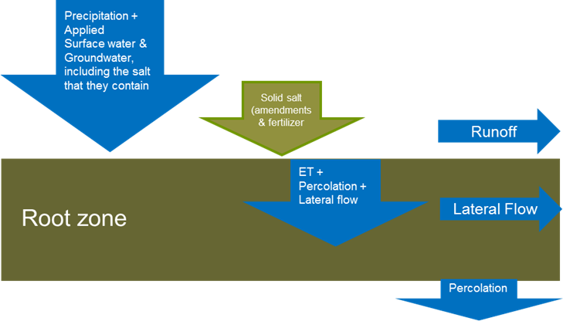
SOIL WATER ASSESSMENT TOOL (SWAT)
Percolation (Flow)
Percolation (Concentration)
Groundwater Flow & Transport Models
Wells (Municipal and agricultural)
Streams
Recharge (Percolation volume & mass loading from root zone)
Boundary fluxes (Lateral Flow)
MODFLOW-2000
Fluxes
MT3DMS
Groundwater Model Development:
38 layers; ¼ x ¼ mile grid

Slide 9
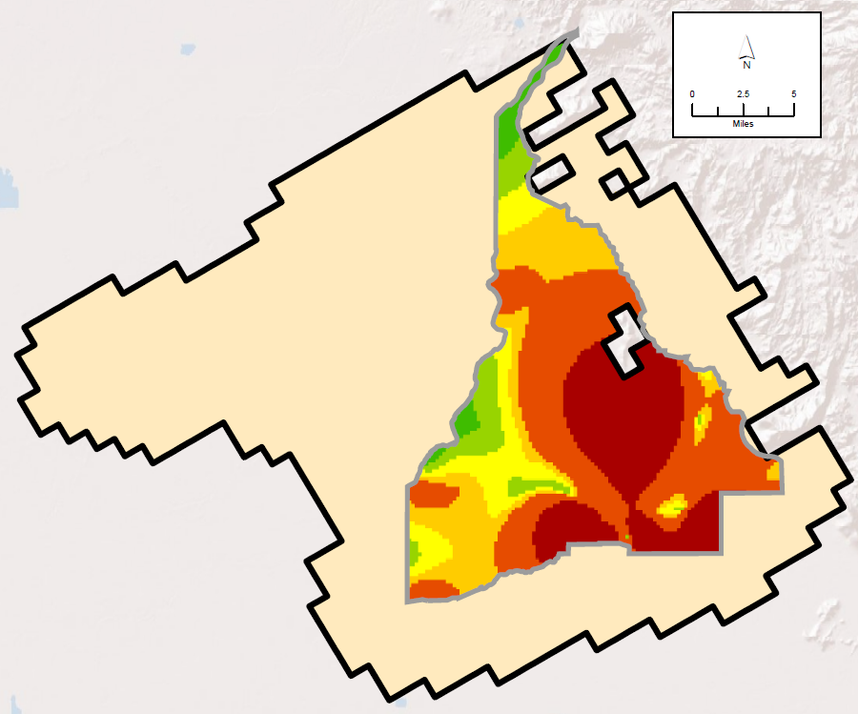
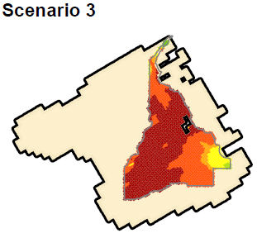
Upper Zone Nitrate Mostly >MCL
Ambient Upper Zone: Actual/Observed
Nitrate Management:
BMP Scenario 3 (less N & Irrigation Efficiency)
Nitrate Today
After 5 Years
After 50 Years
After 100 Years
WQ Declines
WQ Declines

Slide 10
Scenario 4 – Extreme No Ag*
No Ag Irrigation & Only Current Recharge Projects
No Recharge from Ag Irrigation
No new IRWMP Projects
No Nitrogen Loading from Ag
No Dairies
No Irrigated Lands
POTW Effluent Remains the Same
Scenario 4
*This scenario tests an extreme condition where there is no irrigated
agriculture to understand what could be achieved in the absence of ag.
This is NOT a proposed management approach.

Slide 11
AID Baseline
WATER INFLOWS & OUTLFOWS
AID Extreme
No-Ag
Pumping
135,000
Recharge
50,000
Pumping
7,000
Recharge
16,000
Stream
4,600
Stream
4,100
East/West
158,000
East/West
168,000
South
113,000
South
115,000
Upper to Production
78,000
Upper to Production
81,000
To Lower Zone
49,000
To Lower Zone
55,000
(AFY)
(AFY)
Notes:
ROUNDED FLOW AFY

Slide 12
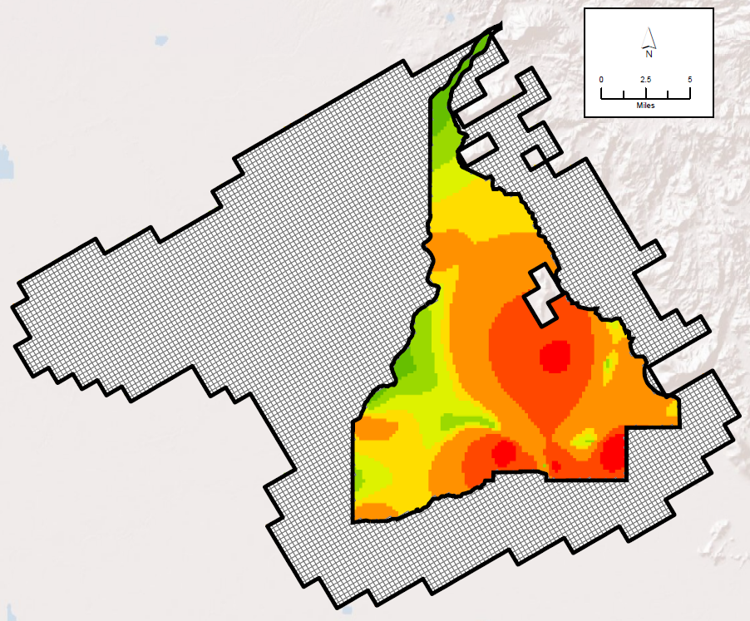
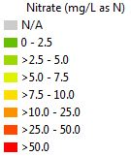
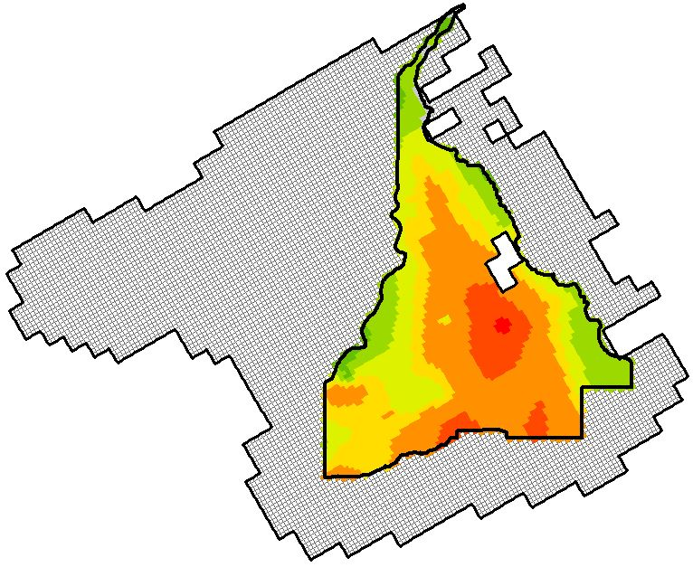
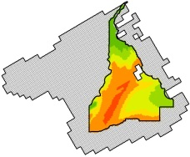
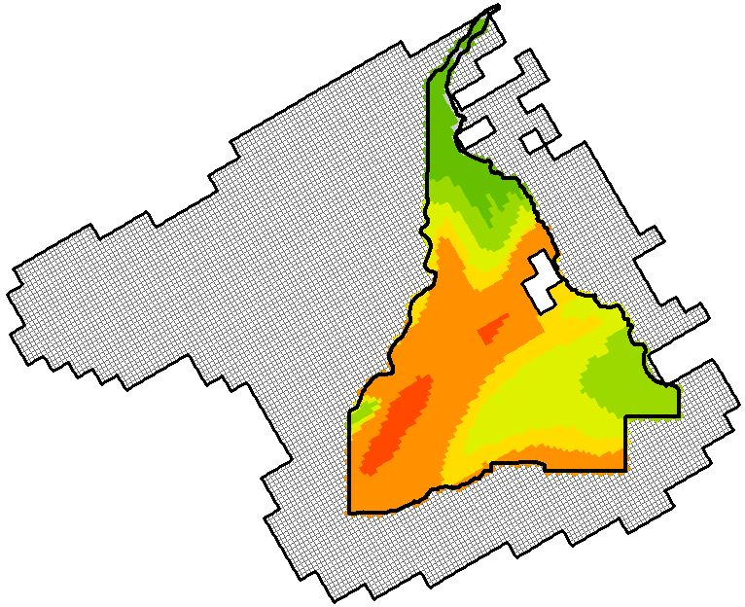
Upper Zone Nitrate Large Area >MCL After 100 Years
Ambient Upper Zone: Actual/Observed
Nitrate Management:
Future No Ag Simulation
Nitrate Today
After 5 Years
After 50 Years
After 100 Years
>5-7.5 mg/L
WQ Improves
WQ Improves
Still
>10mg/L

Slide 13
Restoration Methodology: Examples
Pump/Treat/Reinject
Considerations:
Existing ambient GW quality
Proximity to disadvantaged communities
Land use and mass loading
2. On-Farm Winter Recharge
Considerations:
Use excess stormwater (47,000 AF)
Identify suitable recharge area
Benefit quantity & quality
UPPER
LOWER
High Recharge Potential
7,600 acres

Slide 14
Simulated Nitrate Concentrations in AID Upper Zone
UPPER ZONE
 | 5 Yrs | 10 Yrs | 20 Yrs | 50 Yrs | 100 Yrs
Initial Ambient | Scenario #3 (NO On-Farm Recharge or Extraction/Injection Rest. Activities)
Initial Ambient | Plan B (Half Scen #3 Nitrogen Loading WITH Local On-Farm Rech. & Ext/Inject.)
After 100 Yrs Large Area >MCL
Improved GWQ near recharge area and target communities
Restoration Partially Feasible
Notes:
Pump, Treat, and Reinject:
Targeted approach for restoration works better in smaller geographic settings
More control; knowledge about the transport of water and nitrate mass
Applying pump, treat, and reinject designs to large regional areas is not practicable
Too many other complications (non-point sources, local pumping stresses, and lateral influxes that interfere with the movement and restoration of the water)
On-Farm Recharge:
Advantageous for flushing the root zone
Recharge effects may be seen downgradient; may be affected by nearby pumping stresses
Can displace existing poor shallow water quality causing this water to move downward into lower parts of the aquifer system
Factors such as soil and subsurface texture, hydrogeologic setting, the presence of deep ripping, and the depth to the water, affect ability of an area to transmit water into the aquifer.

Slide 15
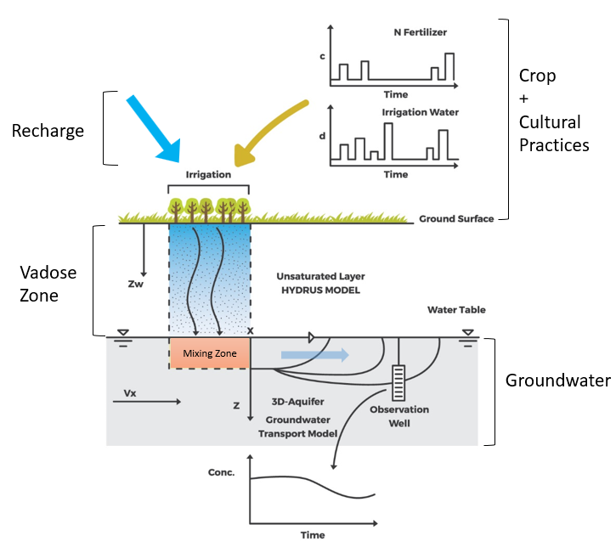
CDFA On-Farm Stormwater Recharge Project
Assess effect of recharge efforts on GW quality.
Regional Board recognition of salt and nitrate in vadose zone and potential for short-term WQ degradation near recharge sites.
Although enhanced natural recharge and/or intentional recharge operations may increase nitrate and/or salt concentrations initially, the long-term quantity and quality benefits of recharge will likely outweigh initial effects.
Tulare Lake Hydrologic Region:
Growers with Almonds, Grapes, or Tomatoes

Slide 16
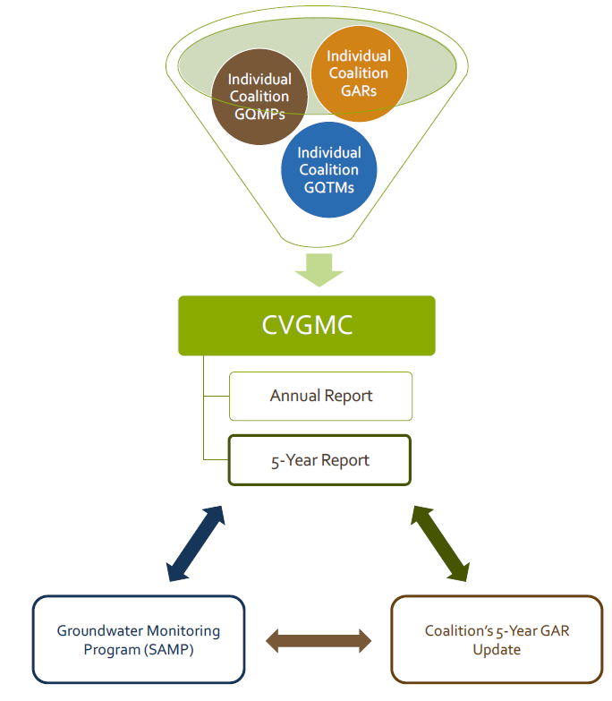
SGMA and Synergies with Other Programs
GW quality characterization & GW quality trend monitoring (ILRP GQTM; CVGMC 10 Ag Coalitions)
GW conditions/conceptualization (SGMA)
Develop comprehensive understanding of GW system to inform management strategies, including feasibility and effectiveness
Sustainability indicator monitoring
Consider alignment of GSAs
with MZs (SGMA/BPA/ILRP)
Maintain local flexibility
Coordinate SGMA management
actions/projects with salt & nitrate
management strategies
Surveillance & monitoring program
(CV GW Monitoring Program)
BPA Management Zone (MZ)
Groundwater Sustainability Agency
Irrigated Lands Regulatory Program Coalition

Slide 17
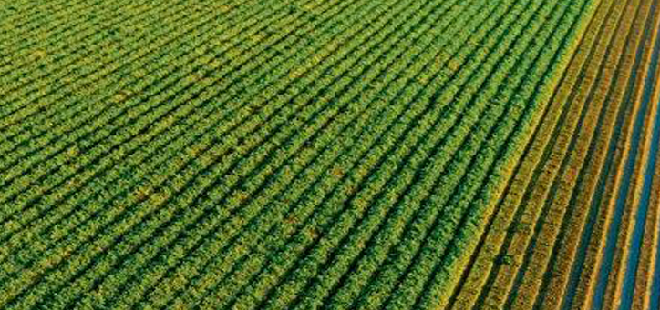
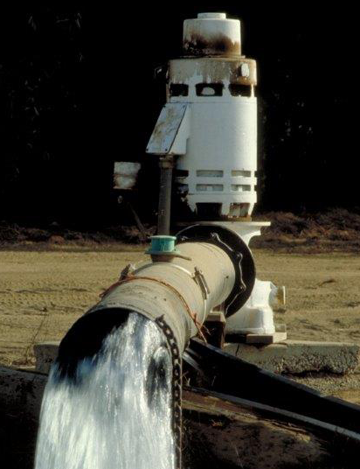
Thank You

